Slide 1
Tribal Medicare and Medicaid
Legislative Priorities
July 27, 2026

Slide 2
Medicaid Priorities

Slide 3
Medicaid #1: Equalize Medicaid Coverage Across Indian Country
Medicaid coverage for AI/ANs varies depending on which state the patient is in.
The federal trust and treaty obligation applies regardless of the State a Tribe is located in.
Congress should allow Indian Health Care Providers to bill Medicaid for all mandatory, optional, and IHCIA-authorized services, regardless of whether the state authorizes these services for other providers.
This would not impose any cost on states, which receive 100% FMAP when an IHS beneficiary sees an Indian Health Care Provider.

Slide 4
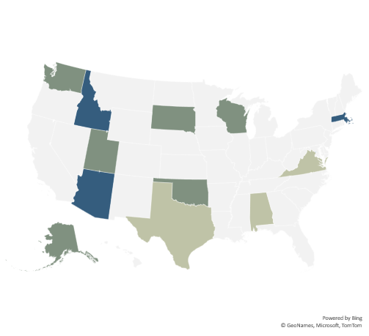
Example: Optional Dental Coverage Varies Across Indian Country
2018
Limited prior authorization
Non-emergency services capped at $1000/year
One cleaning annually with limits on other services
Full coverage
Full coverage
Non-emergency services for pregnant and disabled only
No coverage
Full coverage for Tribal citizens through IHS/Tribal facilities only
No coverage
Prior authorization; $1,150/year cap for non-emergent adult care
Limits on how often care can be received
No coverage

Slide 5
Mandatory Services | Optional Services | Optional Services (cont.) | Additional SSA-Authorized Services | IHCIA-Authorized Services
Transportation to medical care | Other licensed practitioner services | Community First Choice Option | In vitro diagnostic products | Long-term care services
Inpatient hospital services | Private duty nursing services | Personal care | Services furnished under a PACE program | Community Health Aide Program services
Outpatient hospital services | Clinic services | Primary care case management | Community supported living arrangements services | Health promotion and disease prevention services
Rural health clinic services | Dental services | Primary and secondary medical strategies, treatment, and services for individuals with sickle cell disease | Home and community care for functionally disabled elderly individuals | Diabetes prevention, treatment, and control services
Federally qualified health center services | Physical therapy | State plan home and community-based services | Certified community behavioral health clinic services (jj) | Hospice care
Laboratory and X-Ray services | Occupational therapy | Self-directed personal assistance services |  | Assisted living services
Nursing facility services | Speech, hearing and language disorder services | Respiratory care for ventilator-dependent individuals |  | Community Health Representative Program services
Family planning services | Prescription drugs | Alternative Benefit Plan |  | Home-and community-based services
Early and Periodic Screening, Diagnostic, and Treatment services | Dentures | Health homes for enrollees with chronic conditions |  | Mental health prevention and treatment services
Tobacco cessation counseling for pregnant women | Prosthetics | Other services approved by Secretary: religious nonmedical health care institution |  | Prevention, control, and elimination of communicable and infectious diseases
Physician services | Eyeglasses | Other services approved by Secretary: critical access hospital |  | Behavioral health prevention and treatment services
Home health services | Other diagnostic, screening, preventive, and rehabilitative services | Other services approved by Secretary: emergency hospital services by a non-Medicare certified hospital |  | Domestic and sexual violence prevention and treatment
Nurse midwife services | Hospice
Certified pediatric and family nurse practitioner services | Services in an intermediate care facility for individuals with intellectual disability
Freestanding birth center services when licensed or otherwise recognized by the state | Inpatient psychiatric services for individuals under 21
Medication Assisted Treatment | Case management
Routine patient costs of items and services for beneficiaries enrolled in qualifying clinical trials | Services for individuals 65+ in an Institution for Mental Disease
Alternative Benefit Plan (Expansion pop.) | TB-related services

Slide 6
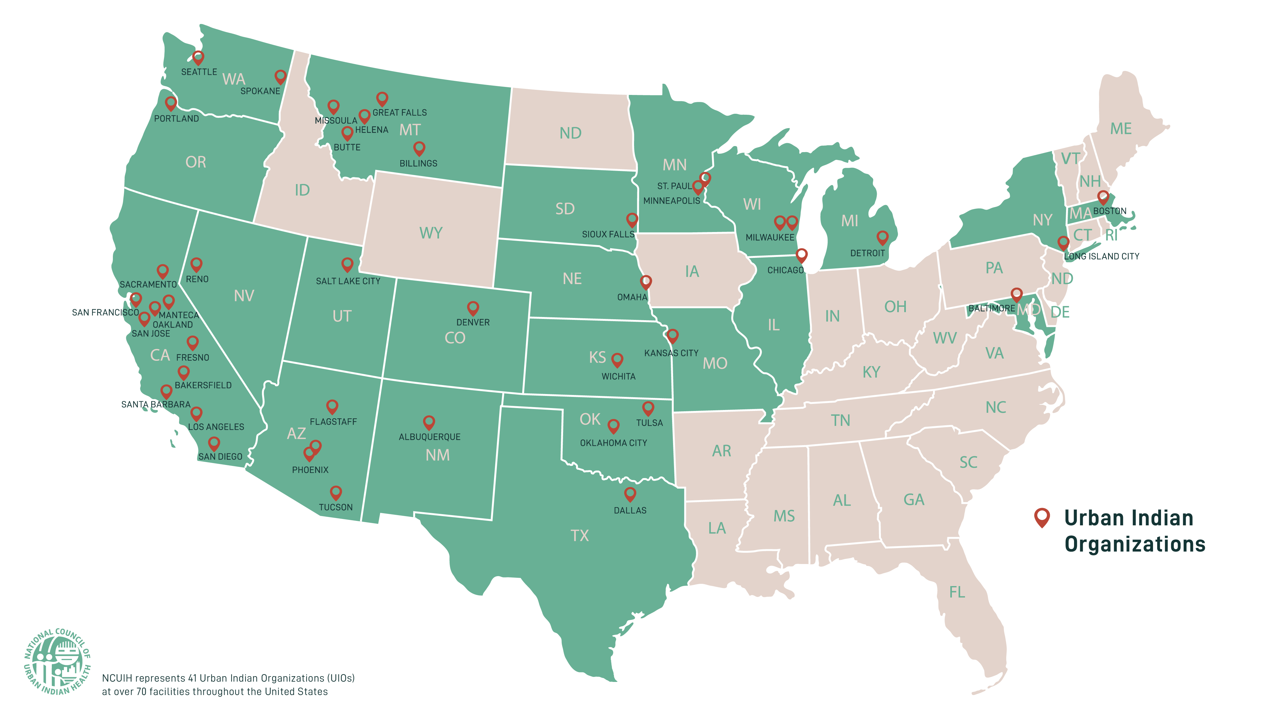
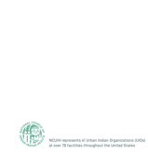
Medicaid #2: 100% Federal Reimbursement for Urban Indian Organizations
The federal government has a treaty and trust responsibility to provide health care services to Tribal Nations and their citizens.
The federal government currently covers the entire cost of Medicaid services provided to AI/AN beneficiaries at IHS and Tribal facilities, but not UIOs.
Congress should permanently authorize a 100% FMAP for services received through Urban Indian Organizations.

Slide 7
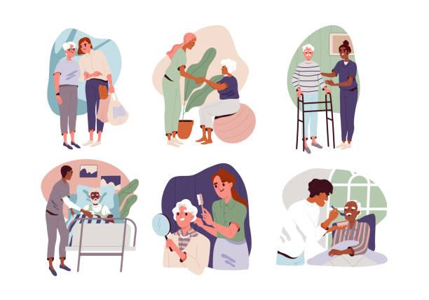

Medicaid #3: Cover Services Delivered in Non-Facility Settings
An essential part of the Indian health system is services provided in non-facility settings, including schools, community centers, and patient homes.
Many Tribal communities are too small or remote to have a brick-and-mortar clinic, so all local services are provided in the community.
CMS previously interpreted the definition of “clinic services” narrowly, prohibiting Medicaid coverage for services in the community.
The CY2025 OPPS Final Rule fixed this administratively.
Congress should statutorily ensure the “clinic services” definition allows reimbursements for services furnished by IHS and Tribal clinics wherever the care is delivered.

Slide 8
Medicare Priorities

Slide 9

Medicare #1: Exempt Tribal Elders from Medicare Cost-Sharing
$
$
$
Congress exempted Tribal citizens from Medicaid cost-sharing because of the federal government’s obligation to provide healthcare to Tribal Nations.
No similar exemption exists for Medicare.
$
$
$
$
$
$
$
$
$
$
$
$
Congress should exempt AI/AN beneficiaries from Medicare premiums and deductibles, as was done for Medicaid.
$
$
$
$
$
$
$
$
$
$
$
$
Medicaid
Medicare
Tribal citizens’ cost-sharing skyrockets when enrolling in Medicare.

Slide 10
Medicare #2: Reimburse Indian Health Care Providers Fully for Care to Tribal Elders
Indian Health Care Providers are only reimbursed for 80% of the cost of providing care to Medicare-enrolled Tribal elders.
Medicare expects the patient to pick up the other 20% as the cost-share, but IHS cannot bill patients for the service, and Tribal providers do not collect from these patients.
As a result, IHS and Tribal facilities are only being paid 80 cents on the dollar for Medicare services compared to other providers.
Congress should mandate Medicare reimburse Indian Health Care Providers at 100% of the cost of their services.

Slide 11
Medicare #3: Reimburse Tribal-Specific Provider Types
Due to chronic understaffing and lack of adequate resources, Tribal-specific provider types regularly provide vital care to Tribal citizens.
  Community Health Aide/Practitioner (CHA/P): Primary, emergent, and chronic care.
  Behavioral Health Aide/Practitioner (BHA/P): Mental health education, prevention, intervention, and crisis management.
  Dental Health Aide Therapists (DHAT): Cleanings, fillings, basic extractions, etc.
  Indian Health Program Pharmacists: Medication-assisted treatment for substance use disorders, Asthma stabilization, etc.

Slide 12
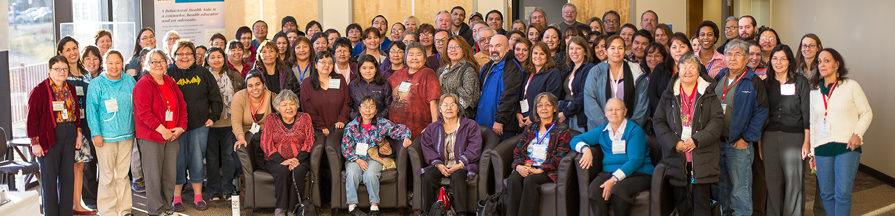
Medicare #3: Reimburse Tribal-Specific Provider Types
For many remote communities, CHA/Ps, BHA/Ps, DHATs, and Indian Health Program Pharmacists are the only in-community providers.
Medicaid reimburses for their services, but Medicare does not.
Congress should make these provider types eligible for Medicare reimbursement as Indian Health Care Providers.

Slide 13

Medicare #4: Permanently Extend Medicare Telehealth Flexibilities
Telehealth is critical for Tribal elders who are rurally located, without transportation services, or home-bound.
Congress should permanently authorize Medicare reimbursement of telehealth services provided through the IHS, Tribal, and Urban Indian facilities.

Slide 14
Anti-Kickback Statute Priority

Slide 15
Anti-Kickback Statute: Enact a Tribal Safe Harbor
Congress created a safe harbor for federally qualified health centers (FQHCs) in Section 431 of the Medicare Modernization Act of 2003.
But many Indian Health Care Providers do not have access to the FQHC safe harbor because the FQHC is not broad enough to include all IHS and Tribal health care providers, including hospitals.
At present, compliance concerns prevent Indian Health Care Providers from expanding access to needed care from outside primary and specialty care providers.
Congress should establish an Anti-Kickback Statute safe harbor for Indian health care providers.

Slide 16
Questions?

